Slide 1

Sheltered Instruction
WS# 90233
Karina E. Chapa, M.Ed.
Language Proficiency, Biliteracy and Cultural Diversity Director
kchapa@esc1.net
Twitter @esc1bilingual @bilingualpride

Slide 2

Professional Learning Essential Agreements
Be respectful of others
Be an active participant
Take care of your needs
Use electronic devices as learning tools
©2018 Region One Education Service Center

Slide 3
Sheltered instruction

Slide 4
Session Objectives
Content Objective
Language Objective
Today I will explore sheltered instruction techniques and strategies to make content comprehensible for my English Learners.
Today I will share orally and in writing different ideas on how to implement sheltered instruction strategies in the classroom.

Slide 5

Blah School
Teacher
Student
©2018 Region One Education Service Center

Slide 6
But what if the lessons were in English?
©2018 Region One Education Service Center

Slide 7
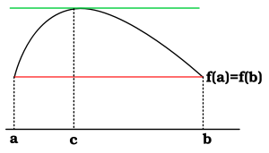
Rolle’s Theorem
If a function f is continuous on a closed interval [a,b] and differentiable on the open interval (a,b), and f(a) = f(b) then there is some number c in the open interval (a,b) such that f '(c) = 0.
©2018 Region One Education Service Center

Slide 8
Canterbury Tales
When that April with his showers soote The drought of March hath pierced to the root And bathed every vein in such liquor Of which virtue engendered is the flower; When Zephyrus eke with his sweete breath Inspired hath in every holt and heath The tender croppes, and the younge sun Hath in the Ram his halfe course y-run.
©2018 Region One Education Service Center

Slide 9

©2018 Region One Education Service Center

Slide 10
All content teachers ARE language teachers!
©2018 Region One Education Service Center

Slide 11
Speak like scientists!
Speak like mathematicians!
All content teachers ARE language teachers!
Speak like historians!
©2018 Region One Education Service Center

Slide 12
Factors Affecting Second Language Acquisition
Motivation and attitude Age
First language development Personality
Language Distance Access to the language
Cultural background Peers and role models
Quality of instruction
Take a Stand
©2018 Region One Education Service Center

Slide 13
Jigsaw Reading ~ Padlet
©2018 Region One Education Service Center

Slide 14

Jigsaw Reading Padlet
Form groups of five.
Read your assigned section.
Write 3 bullets summarizing the information.
Upload a picture or a video representing the information you read, along with the 3 bullets.
http://bit.do/PadletCAL
©2018 Region One Education Service Center

Slide 15
Content and language objectives

Slide 16

Anticipation Guide
kahoot.it
create.kahoot.it
Let’s Kahoot!

Slide 17
Round Table
Divide a piece of paper in two sections
Create a T chart
Write everything you know about content and language objectives
15 seconds!
Pass your paper to your right!
Repeat!
Content Objectives
Language Objectives
Let’s Write!

Slide 18
The What and the How
Content Objectives come from the TEKS
What am I going to learn?
Language Objectives come from the ELPS
How will I demonstrate my learning through listening, speaking, reading and/or writing?
Content and Language Objectives

Slide 19
Content Objective - Sample
Science TEKS: Differentiate between structure and function in plant and animal cell organelles including cell membrane, cell wall, nucleus, cytoplasm, mitochondria, chloroplast and vacuole.
Student Friendly format: Today I will compare and contrast the cell structures and functions of plants and animals.

Slide 20

Let’s Connect!
Student Expectations and Thinking Maps
©2018 Region One Education Service Center

Slide 21
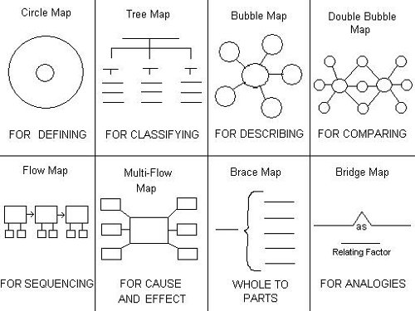
©2018 Region One Education Service Center

Slide 22

Content Objective - Sample
Science TEKS: Differentiate between structure and function in plant and animal cell organelles including cell membrane, cell wall, nucleus, cytoplasm, mitochondria, chloroplast and vacuole.
Student Friendly format: Today I will compare and contrast the cell structures and functions of plants and animals.

Slide 23
Writing Content Objectives
Pair-up
Analyze a Student Expectation (TEKS) from any content area
Write it in a student-friendly format
You have 5 minutes
Write it on the top of a chart paper
Today I will…

Slide 24
Science TEKS: Differentiate between structure and function in plant and animal cell organelles including cell membrane, cell wall, nucleus, cytoplasm, mitochondria, chloroplast and vacuole.
CONTENT OBJECTIVE
Today I will compare and contrast the cell structures and functions of plants and animals.
©2018 Region One Education Service Center

Slide 25
Language Objective - Sample
Content Objective:
Today I will compare and contrast the cell structures and functions of plants and animals.
Language Objective:
Today I will write an essay comparing and contrasting plant and animal cells utilizing a double-bubble map.

Slide 26
Writing Language Objectives
Pair-up
Look back at the content objective you wrote
Write a language objective in a student-friendly format
You have 5 minutes
Write it on the chart paper below the content objective
Today I will…

Slide 27
Science TEKS: Differentiate between structure and function in plant and animal cell organelles including cell membrane, cell wall, nucleus, cytoplasm, mitochondria, chloroplast and vacuole.
CONTENT OBJECTIVE
Today I will compare and contrast the cell structures and functions of plants and animals.
LANGUAGE OBJECTIVE
Today I will write an essay comparing and contrasting plant and animal cells utilizing a double-bubble map.
©2018 Region One Education Service Center

Slide 28
Science TEKS: Differentiate between structure and function in plant and animal cell organelles including cell membrane, cell wall, nucleus, cytoplasm, mitochondria, chloroplast and vacuole.
CONTENT OBJECTIVE
Today I will compare and contrast the cell structures and functions of plants and animals.
LANGUAGE OBJECTIVE
Today I will write an essay comparing and contrasting plant and animal cells utilizing a double-bubble map.
Gallery Walk!
©2018 Region One Education Service Center

Slide 29
Key Points to Remember
Make objectives student friendly and appropriate for grade level
Objectives are for students, not for the adults in the classroom
Post eye level
Review with students before, during and after each lesson

Slide 30
Speaking in complete sentences

Slide 31
1-2-4-ALL
Why is it important to encourage English Learners to speak in complete sentences?
Write your individual answer on a piece of paper.
Share with a partner and add any new ideas to your paper.
Now share with another pair your answers and keep adding new ideas to your own papers.
As a whole table come up with a final complete answer.

Slide 32
Use of Complete Sentences
Does this mean that students need to answer in complete sentences all the time?
TIP:
Provide students with sentence frames and sentence starters if they are struggling to produce complete thoughts in English.

Slide 33
Use of Complete Sentences
  1. When reviewing a handout or worksheet
    Non-Example
    Teacher: How much is 5 X 4?
    Student: 20!
    Example
    Teacher: What is the product of 5 X 4?
    Student: The product of 5 and 4 is 20

Slide 34
Use of Complete Sentences
  2. When students are given sentence starters
    Non-Example
    Teacher: Who is your favorite character and why?
    Student: Esperanza!
    Example
    Teacher: Who is your favorite character and why? Please complete the following sentence: “My favorite character is… because…”
    Student: My favorite character is Esperanza, because she was very brave.

Slide 35
Your Turn! Gallery Walk!
Go to your Content and Language Objectives poster.
Write 3 questions and 3 sentence stems that your students might be able to use throughout the lesson.
Write them on post-its and place them on your chart paper.

Slide 36
RANDOMIZATION TECHNIQUES

Slide 37
Randomization Techniques
Write-Read-Read-Trade
Stand up when you complete in writing one of these sentences:
  I select who I call on by…
  In my classroom, I include randomization because…
  The most beneficial randomization technique I have used is… because…
  Write the same answer in two different post-its.
  Inside-Outside Circle!

Slide 38
Randomization Techniques
Is it possible to randomize and differentiate instruction at the same time?
Randomize and rotate who is called on,
so students of all language levels can participate!

Slide 39
Randomization Techniques
Lucky sticks
Beach ball
Index cards
with student names
Class list/roster
Color/numbers
Birthdays
Physical characteristics: longest hair, eye color…
Jenga
Pick up sticks
Career cards
Apps
Popcorn

Slide 40
Developing academic vocabulary

Slide 41
1. When you can complete this sentence in your mind, please stand up.
Academic vocabulary development is important for ALL students, but especially for ELLs, because…

Slide 42
What does this mean?
Carving is appropriate for most green and blue slopes and even some black slopes. However, if you try to carve through moguls, especially in packed powder or corn snow, you’re going to face-plant.

Slide 43
What does this mean?
Carving is appropriate for most green and blue slopes and even some black slopes. However, if you try to carve through moguls, especially in packed powder or corn snow, you’re going to face-plant.

Slide 44


Would this help?
These men are carving.

Slide 45
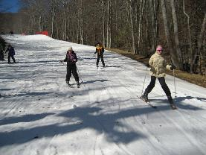
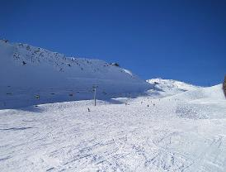
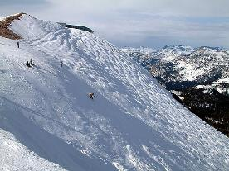
How about this?
Green Slope
Blue Slope
Black Slope

Slide 46
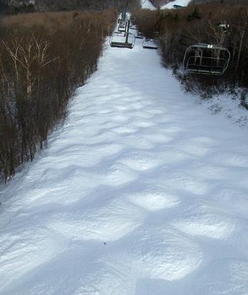
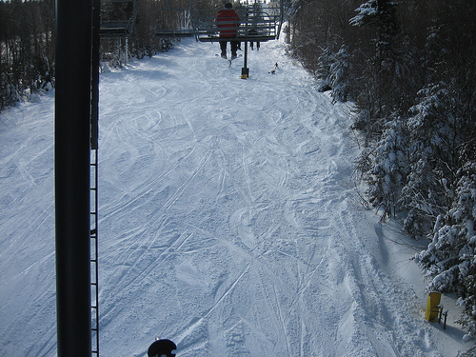
Moguls Packed Powder

Slide 47
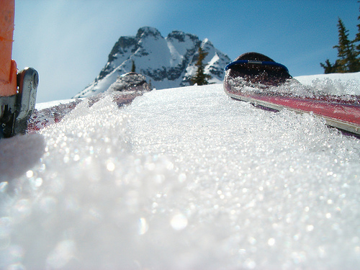
Corn Snow

Slide 48
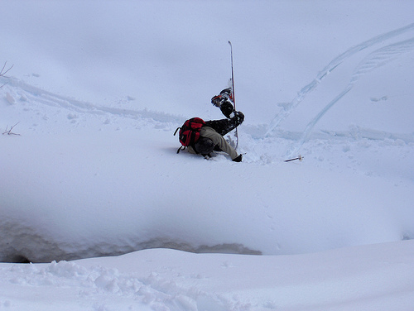
Face-plant

Slide 49









Carving is appropriate for most green and blue slopes
and even some black slopes. However, if you try to carve
through moguls, especially in packed powder or corn snow
you’re going to face-plant.
apropiado
especialmente

Slide 50
Vocabulary Gallery
Each table researches a different vocabulary strategy
Each team creates a poster explaining the activity
Expert Gallery Walk!
Expert Gallery Walk

Slide 51

Conversation Competition
Erase a Word
Vocab Shot
Circle Rotation
Mini Game Show
Guess My Word
That’s Sketchy
Categories
Newspaper Detective
Word Up Baseball
https://www.flocabulary.com/vocabulary-mini-games/
Notes:
3.5 hours

Slide 52
Free Tech tools for english learners

Slide 53

www.mackinvia.com

Slide 54

es.khanacademy.org

Slide 55
Session Objectives
Content Objective
Language Objective
Today I explored sheltered instruction techniques and strategies to make content comprehensible for my ELLs.
Today I shared different ideas on how to implement sheltered instruction strategies in my classroom.

Slide 56

Exit Tickets
I used to think…
But now I know…

Slide 57
Mil gracias
Karina E. Chapa, M.Ed.
Language Proficiency, Biliteracy and Cultural Diversity Director
kchapa@esc1.net
Facebook: Region One ESC Bilingual
Twitter @esc1bilingual @bilingualpride

